Slide 1
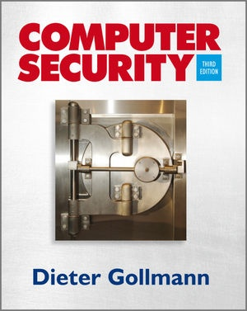
502049 – Introduction to Information Security
Chapter 2: Foundations of Computer Security
Ngoc Tu Huynh, PhD
huynhngoctu@tdtu.edu.vn

Slide 2
Agenda
Security strategies
Prevention – detection – reaction
Security objectives
Confidentiality – integrity – availability
Accountability – non-repudiation
Fundamental Dilemma of Computer Security
Principles of Computer Security
The layer below
Notes:
Phòng ngừa, phát hiện, ứng phó

Slide 3
Computer Security Strategy and Principles
Policy What is the security scheme supposed to do?
Informal description or formal set of rules of desired system behaviour
Consider: assets value; vulnerabilities; potential threats and probability of attacks
Trade-offs: Ease of use vs security; cost of security vs cost of failure and recovery

Slide 4
Computer Security Strategy and Principles
Implementation How does it do it?
Prevention, detection, response, recovery
Assurance Does it really work?
Assurance: degree of confidence that security measures work as intended
Evaluation: process of evaluating system with respect to certain criteria

Slide 5
Security Strategies
Prevention: take measures that prevent your assets from being damaged.
Detection: take measures so that you can detect when, how, and by whom an asset has been damaged.
Reaction: take measures so that you can recover your assets or to recover from a damage to your assets.
The more you invest into prevention, the more you have to invest into detection to make sure prevention is working.

Slide 6
Example 1 – Private Property
Consider the protection of valuable items kept in your private home
Prevention: locks at doors, window bars, walls round the property.
Detection: stolen items are missing, burglar alarms, closed circuit TV.
Reaction: call the police, replace stolen items, make an insurance claim …
Footnote: Parallels to the physical world can illustrate aspects of computer security but they can also be misleading.

Slide 7
Example 2 – E-Commerce
Consider the use of credit card numbers when placing orders over the Internet.
Prevention: encrypt your orders, rely on the merchant to perform checks on the caller, don’t use the Internet (?) …
Detection: an unauthorized transaction appears on your credit card statement.
Reaction: complain, ask for a new card number, etc.
Footnote: Your credit card number has not been stolen; your card can be stolen, but not the number.

Slide 8
Security Objectives
Confidentiality: prevent unauthorised disclosure of information
Integrity: prevent unauthorised modification of information
Data integrity: assure information and programs are changed only in a authorized manner
System integrity: assure system performs intended function
Availability: Assure that systems work promptly and service is not denied to authorized users
Notes:
Users and system inputs are genuine and can be verified and trusted
􏰀 Data authentication
􏰀 Source authentication

Slide 9
Security Objectives
Authenticity: Users and system inputs are genuine and can be verified and trusted
Data authentication
Source authentication
Accountability (non-repudiation): Actions of an entity can be traced uniquely to that entity
Supports: non-repudiation, deterrence, fault isolation, intrusion detection and prevention, after-action recovery and legal action
Notes:
Users and system inputs are genuine and can be verified and trusted
􏰀 Data authentication
􏰀 Source authentication
Actions of an entity can be traced uniquely to that entity
􏰀 Supports: non-repudiation, deterrence, fault isolation, intrusion detection and prevention, after-action recovery and legal action

Slide 10
Confidentiality
Prevent unauthorised disclosure of information (prevent unauthorised reading).
Secrecy: protection of date belonging to an organisation.
Historically, security and secrecy were closely related; security and confidentiality are sometimes used as synonyms.
Do we want to hide the content of a document or its existence?
Traffic analysis in network security.
Anonymity, unlinkability

Slide 11
Privacy
Privacy: protection of personal data (OECD Privacy Guidelines, EU Data Privacy Directive 95/46/EC).
“Put the user in control of their personal data and of information about their activities.”
Taken now more seriously by companies that want to be ‘trusted’ by their customers.
Also: the right to be left alone, e.g. not to be bothered by spam.

Slide 12
Integrity
Prevent unauthorised modification of information (prevent unauthorised writing).
Data Integrity - The state that exists when computerized data is the same as that in the source document and has not been exposed to accidental or malicious alteration or destruction. (Integrity synonymous for external consistency.)
Detection (and correction) of intentional and accidental modifications of transmitted data.

Slide 13
Integrity ctd.
Clark & Wilson: no user of the system, even if authorized, may be permitted to modify data items in such a way that assets or accounting records of the company are lost or corrupted.
In the most general sense: make sure that everything is as it is supposed to be.
(This is highly desirable but cannot be guaranteed by mechanisms internal to the computer system.)
Integrity is a prerequisite for many other security services; operating systems security has a lot to do with integrity.

Slide 14
Availability
The property of being accessible and usable upon demand by an authorised entity.
Denial of Service (DoS): prevention of authorised access of resources or the delaying of time-critical operations.
Maybe the most important aspect of computer security, but few methods are around.
Distributed denial of service (DDoS) receives a lot of attention; systems are now designed to be more resilient against these attacks.

Slide 15
Accountability
At the operating system level, audit logs record security relevant events and the user identities associated with these events.
If an actual link between a user and a “user identity” can be established, the user can be held accountable.
In distributed systems, cryptographic non-repudiation mechanisms can be used to achieve the same goal.
Notes:
Audit: kiểm tra

Slide 16
Non-repudiation
Non-repudiation services provide unforgeable evidence that a specific action occurred.
Non-repudiation of origin: protects against a sender of data denying that data was sent.
Non-repudiation of delivery: protects against a receiver of data denying that data was received.
Danger – imprecise language: has mail been received when it is delivered to your mailbox?
Notes:
ISO 7498-2 defines two types of non-repudiation service.
Non-repudiation with proof of origin. The recipient of data is provided with proof of the origin of data. This will protect against any subsequent attempt by the sender to falsely deny sending the data.
Non-repudiation with proof of delivery. The sender of data is provided with proof of delivery of data. This will protect against any subsequent attempt by the recipient to falsely deny receiving the data.

Slide 17
Non-repudiation
‘Bad’ but frequently found definition: Non-repudiation provides irrefutable evidence about some event.
Danger – imprecise language: is there anything like irrefutable evidence?
Non-repudiation services generate mathematical evidence.
To claim that such evidence will be “accepted by any court” is naïve and shows a wrong view of the world.

Slide 18
Non-repudiation
Typical application: signing emails; signatures in S/MIME secure e-mail system.
Are such signatures analogous to signing a letter by hand?
In the legal system, hand written signatures (on contracts) indicate the intent of the signer.
Can a digital signature created by a machine, and maybe automatically attached to each mail, indicate the intent of a person?

Slide 19
Reliability & Safety
Reliability and safety are related to security:
Similar engineering methods,
Similar efforts in standardisation,
Possible requirement conflicts.
Reliability addresses the consequences of accidental errors.
Is security part of reliability or vice versa?
Safety: measure of the absence of catastrophic influences on the environment, in particular on human life.

Slide 20
Security & Reliability
On a PC, you are in control of the software components sending inputs to each other.
On the Internet, hostile parties provide input.
To make software more reliable, it is tested against typical usage patterns:
“It does not matter how many bugs there are, it matters how often they are triggered.”
To make software more secure, it has to be tested against ‘untypical’ usage patterns (but there are typical attack patterns).

Slide 21
A Remark on Terminology
There is no single definition of security.
When reading a document, be careful not to confuse your own notion of security with that used in the document.
A lot of time is being spent – and wasted – trying to define an unambiguous notation for security.
Our attempt at a working definition of security:
Computer security deals with the prevention an detection of unauthorized actions by users of a computer system.
Computer security is concerned with the measures we can take to deal with intentional actions by parties behaving in an unwelcome fashion.

Slide 22
Computer Security Challenges
Computer security is not as simple as it might first appear to the novice
potential attacks on the security features must be considered
procedures used to provide particular services are often counter-intuitive
physical and logical placement needs to be determined

Slide 23
Computer Security Challenges
additional algorithms or protocols may be involved
attackers only need to find a single weakness, the developer needs to find all weaknesses
users and system managers tend to not see the benefits of security until a failure occurs
security requires regular and constant monitoring
is often an afterthought to be incorporated into a
system after the design is complete
thought of as an impediment to efficient and user-friendly operation

Slide 24
Security Concepts
Assets
System resources that the users/owners wish to protect
Hardware, software, data, communication lines
Vulnerabilities
Weakness in system implementation or operation
Can make asset: corrupted, leaky, unavailable
Security Policy
Set of rules and practices that specifies how a system provides security services to protect assets
Threats
Potential violation of security policy by exploiting a vulnerability
Notes:
Security Policy
􏰀 Set of rules and practices that specifies how a system provides security services to protect assets
Threats
􏰀 Potential violation of security policy by exploiting a vulnerability

Slide 25
Security Concepts
Attack
A threat that is carried out; a successful attack leads to violation of security policy
Active attack: attempt to alter system resources or operation
Passive attack: attempt to learn information that does not affect system resources
Inside attack: initiated by entity with authorized access to system
Outside attack: initiated by unauthorized user of system
Countermeasure
Means to deal with an attack
Prevent, detect, respond, recover
Even with countermeasures, vulnerabilities may exist, leading to risk to the assets
Aim to minimize the risks

Slide 26
Threat Consequences and Attacks
Threat Action An attack
Threat Agent Entity that attacks, or is threat to system (adversary, attacker, malicious user)
Threat Consequence A security violation that results from a threat action
Unauthorized Disclosure: exposure, interception, inference, intrusion
Deception: masquerade, falsification, repudiation
Disruption: incapacitation, corruption, obstruction
Usurpation: misappropriation, misuse
Notes:
Deception: lừa gạt
Disruption: phá vỡ
Usurpation: chiếm đoạt
Misappropriation

Slide 27
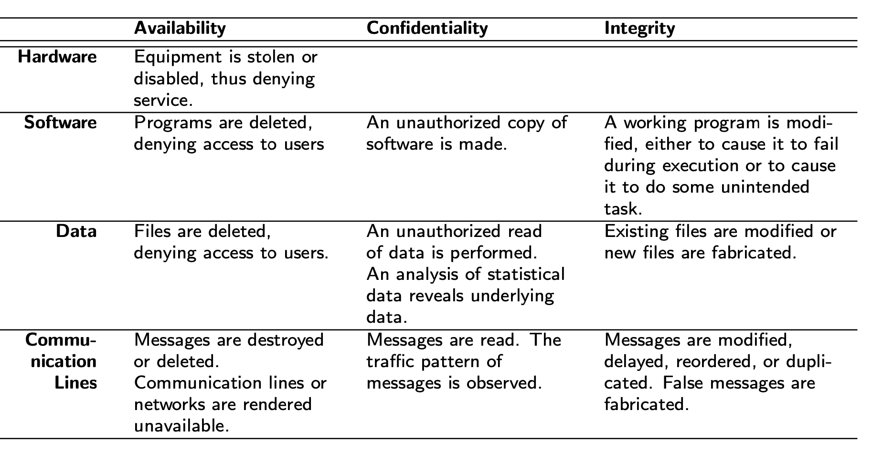
Assets and Examples of Threats
Table 1.3 in Stallings and Brown, Computer Security, 2nd Ed., Pearson 2012

Slide 28
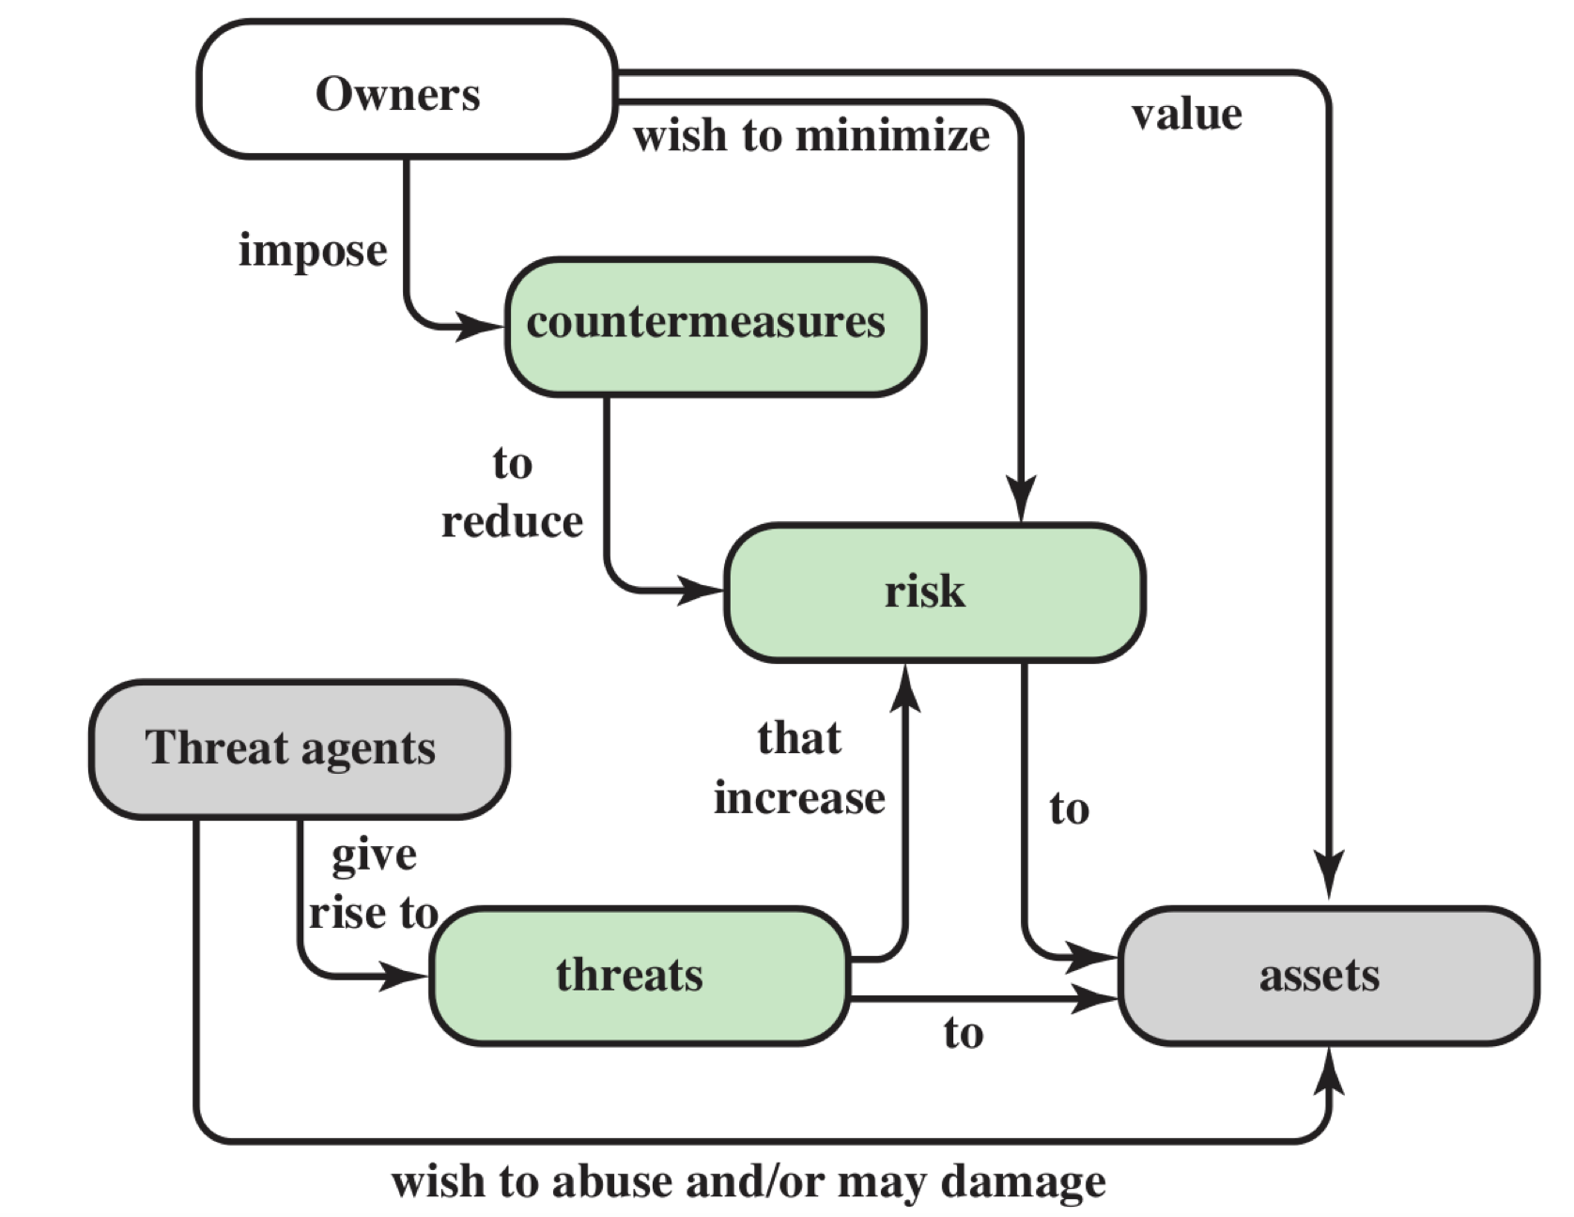
Security Concepts
Figure 1.2 in Stallings and Brown, Computer Security, 2nd Ed., Pearson 2012

Slide 29
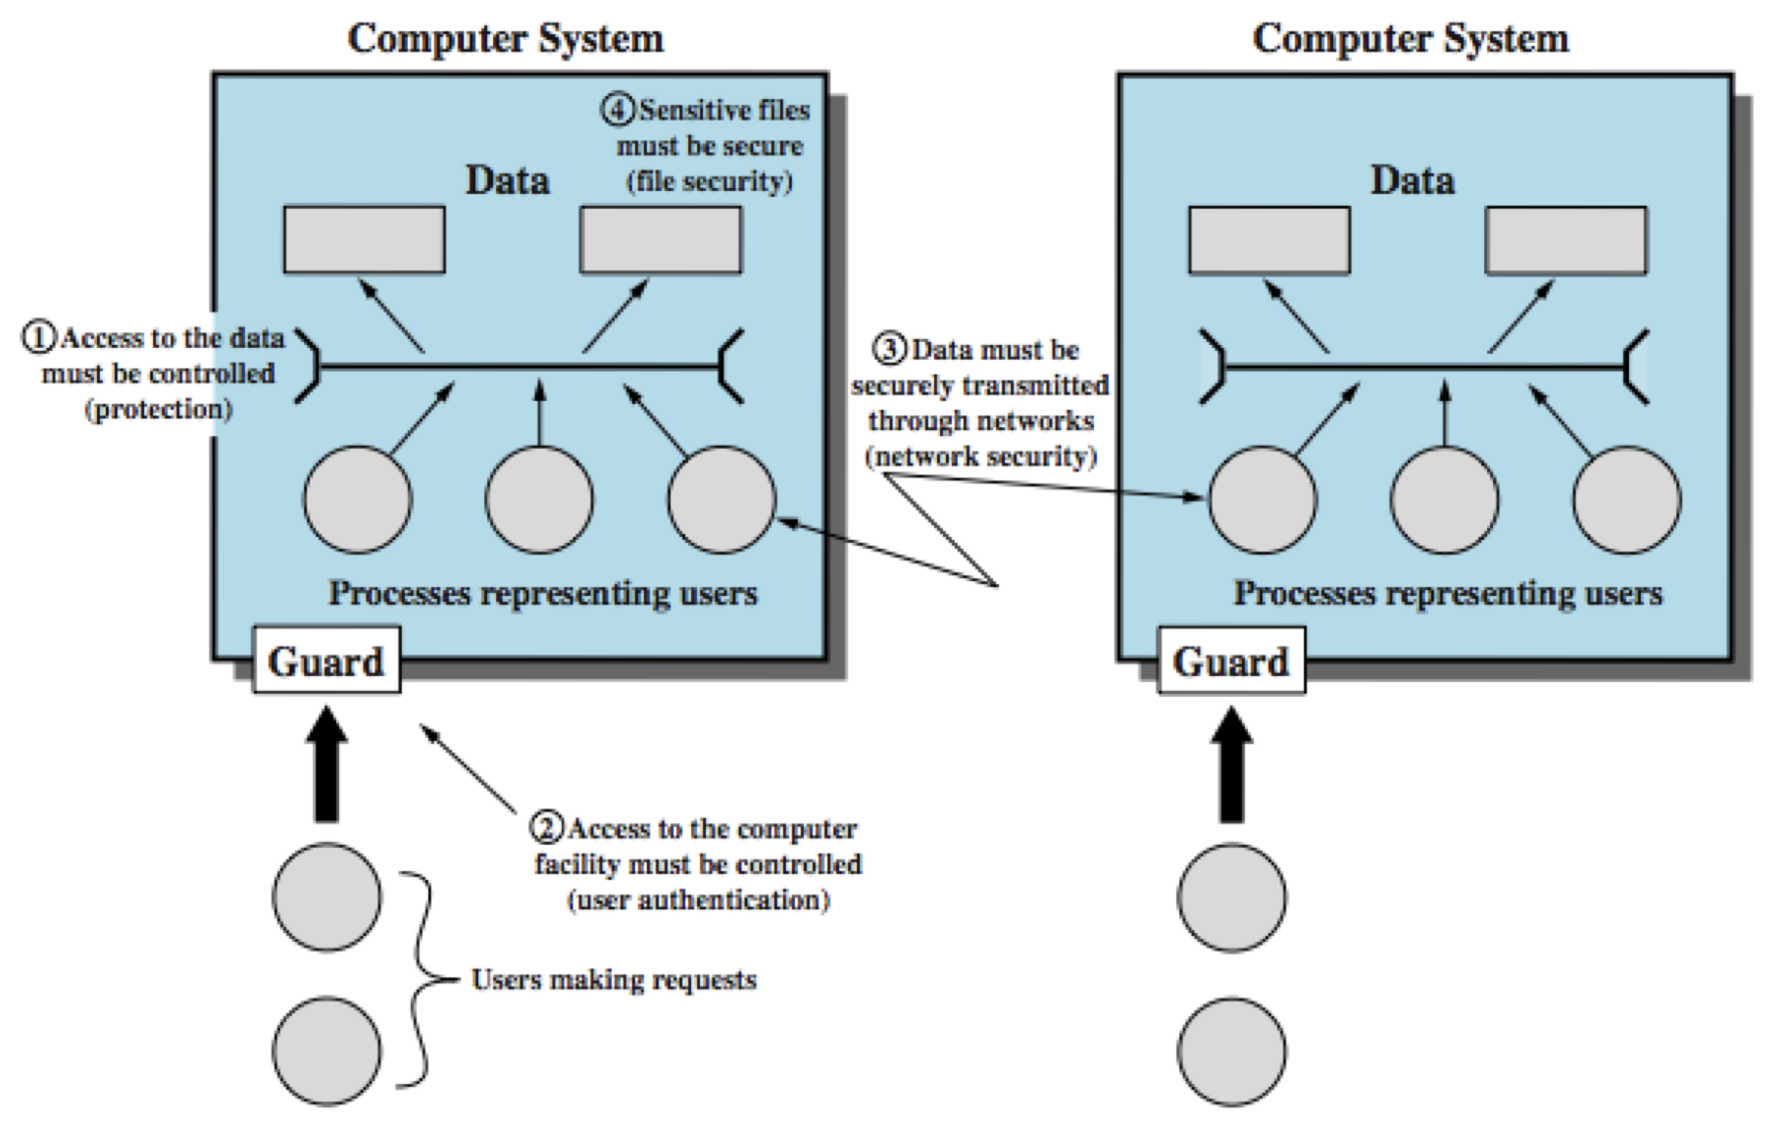
Scope of Computer Security
Figure 1.3 in Stallings and Brown, Computer Security, 2nd Ed., Pearson 2012

Slide 30
Fundamental Dilemma of Computer Security
Security unaware users have specific security requirements but no security expertise.
If you provide your customers with a standard solution it might not meet their requirements.
If you want to tailor your solution to your customers’ needs, they may be unable to tell you what they require.

Slide 31
Principles of Computer Security Dimensions of Computer Security
Application
Software
User
(subject)
Resource
(object)
Hardware

Slide 32
1st Fundamental Design Decision Where to focus security controls?
The focus may be on data – operations – users; e.g. integrity requirements may refer to rules on
Format and content of data items (internal consistency): account balance is an integer.
Operations that may be performed on a data item: credit, debit, transfer, …
Users who are allowed to access a data item (authorised access): account holder and bank clerk have access to account.

Slide 33
2nd Fundamental Design Decision Where to place security controls?
applications
services (middleware)
operating system
OS kernel
hardware

Slide 34
Man-Machine Scale
Visualize security mechanisms as concentric protection rings, with hardware mechanisms in the centre and application mechanisms at the outside.
Mechanisms towards the centre tend to be more generic while mechanisms at the outside are more likely to address individual user requirements.
The man-machine scale for security mechanisms combines our first two design decisions.

Slide 35
Onion Model of Protection
applications
services
operating system
OS kernel
hardware

Slide 36
Man-Machine Scale
specific
complex
focus on users
generic
simple
focus on data
man
oriented
machine
oriented

Slide 37
Data & Information
Data are physical phenomena chosen by convention to represent certain aspects of our conceptual and real world. The meanings we assign to data are called information.
Information and data lie on the two ends of the man-machine scale.
The distinction between data and information can be subtle but causes some of the more difficult problems in computer security.

Slide 38
Data & Information
Controlling access to information may be elusive and need to be replaced by controlling access to data.
If information and corresponding data are closely linked the two approaches give very similar results, but this is not always the case.
Covert channels: response time or memory usage may signal information.
Inference in statistical databases: combine statistical queries to get information on individual entries.

Slide 39
3rd Fundamental Design Decision Complexity or Assurance?
Often, the location of a security mechanism on the man-machine scale is related to its complexity.
Generic mechanisms are simple, applications clamour for feature-rich security functions.
Do you prefer simplicity – and higher assurance – to a feature-rich security environment?

Slide 40
3rd Fundamental Design Decision Complexity or Assurance?
Fundamental dilemma:
Simple generic mechanisms may not match specific security requirements.
To choose the right features from a rich menu, you have to be a security expert.
Security unaware users are in a no-win situation.
Feature-rich security and high assurance do not match easily.

Slide 41
4th Fundamental Design Decision Centralized or decentralized control?
Within the domain of a security policy, the same controls should be enforced.
Having a single entity in charge of security makes it easy to achieve uniformity but this central entity may become a performance bottleneck.
A distributed solution may be more efficient but you have to take added care to guarantee that different components enforce a consistent policy.
Should a central entity define and enforce security or should these tasks be left to individual components in a system?

Slide 42
Security Perimeter
Every protection mechanism defines a security perimeter (security boundary).
The parts of the system that can malfunction without compromising the mechanism lie outside the perimeter.
The parts of the system that can disable the mechanism lie within the perimeter.
Note: Attacks from insiders are a major concern in security considerations.

Slide 43
5th Fundamental Design Decision Blocking access to the layer below
Attackers try to bypass protection mechanisms.
There is an immediate and important corollary to the second design decision:
How do you stop an attacker from getting access to a layer below your protection mechanism?

Slide 44
Access to the Layer Below
controlled access
security perimeter
physical access control and administrative measures

Slide 45
Information Security Principles
NIST Guide to General Server Security
Simplicity
Fail-safe
Complete Mediation
Open Design
Separation of Privilege
Least Privilege
Psychological Acceptability
Least Common Mechanism
Defense-in-Depth
Work Factor
Compromise Recording

Slide 46
Summary
Security terminology is ambiguous with many overloaded terms.
Distributed systems security builds on computer security and communications security.
Two major challenges in computer security, are the design of access control systems that fit the requirements of the Internet and the design of secure software.
In security, understanding the problem is more difficult than finding the solution.

Slide 47
Key points
Objectives: confidentiality, integrity, availability
Protect assets: hardware, software, data, comms
Attacks:
Passive: release message, traffic analysis
Active: masquerade, replay, modification, DoS
Inside or outside
Countermeasures, Security mechanisms: techniques to prevent, detect, recover from attacks; often use cryptographic techniques

